Slide 1

Data For Good Social Media Datathon Challenge
Group 9
Douglas Thoms
Farhad Kerimov

Slide 2
Definitions
Business problem: How can we increase engagement?
What is engagement?
An interaction with a tweet such as retweeting, liking (favorite), or replying
Why is engagement useful?
Engagement is useful for a variety of purposes (e.g. increase awareness of an issue, increase attendance for an event, etc). In general, the purpose is to increase visibility on social media.
We used ‘Favorite Count’ and ‘Retweet Count’ to measure engagement in the given dataset

Slide 3
Objective
Increase retweets and favorites to improve visibility of organizations’ activities and strengthen network allies.

Slide 4
Recommendations to achieve the objective
Engaging (by replying and quoting) others’ tweets may increase chances to increase engagement
Deploy hashtags strategically in own tweets, replies to and quotes of others.
Avoid retweeting only: data shows retweeting has little impact
Engage with specific, relevant, and busy accounts. For example: @RegionWaterloo has over 79K followers and tweets regularly on a variety of topics

Slide 5
Overview of our analysis
Methodology:
Made use of Python’s matplotlib library for visualizations
Counted occurrences of use and non-use of features of organizations’ strategies on social media such as media, quotes, in the tweets with engagement levels at the 75th percentile (2 favorites, 3 retweets)
Compared the impact of use and non-use of features on engagement of the entire dataset
Our main observation in the data is that organizations adopted similar strategies on social media, which do not make significant impact on engagement. We argue that they need to engage with other accounts by replying, tagging them, deploying hashtags in own tweets and quotes instead of simply retweeting.

Slide 6
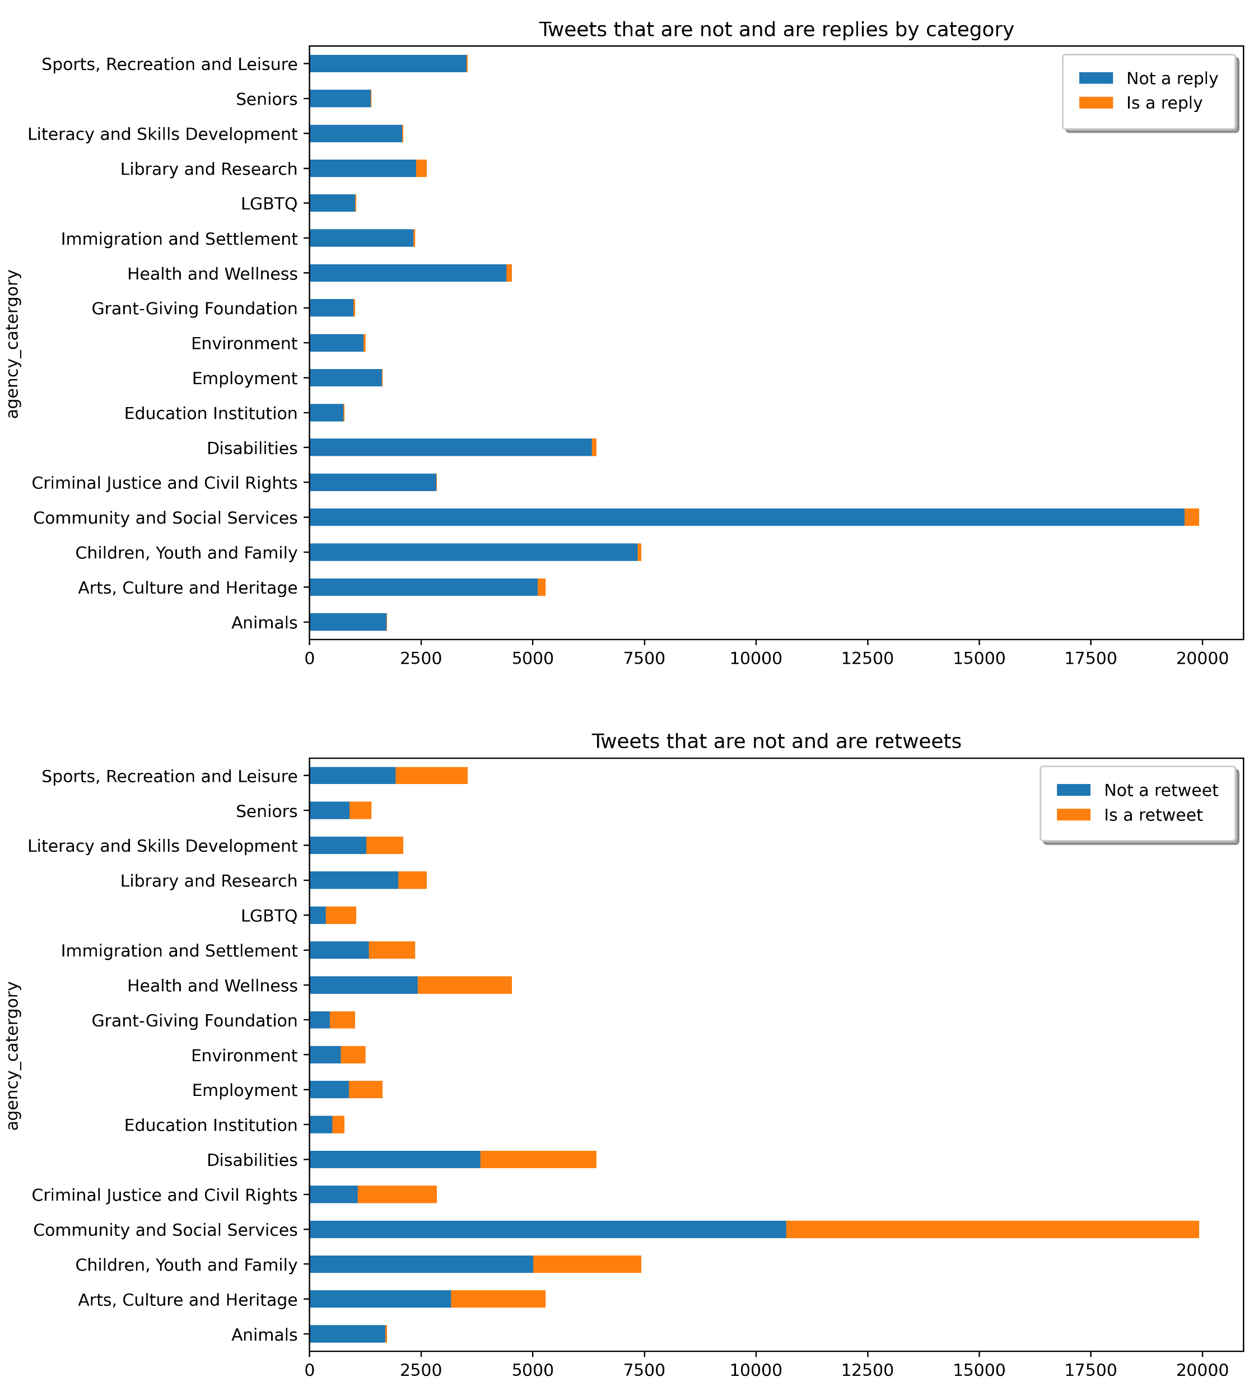
Patterns in the strategies
Organizations behave mostly in the same way:
Little use of media
Little use of hashtags
Mostly retweet
(bars count tweets of 75th percentile, which is 2 favorites and 3 retweets)
Results…

Slide 7
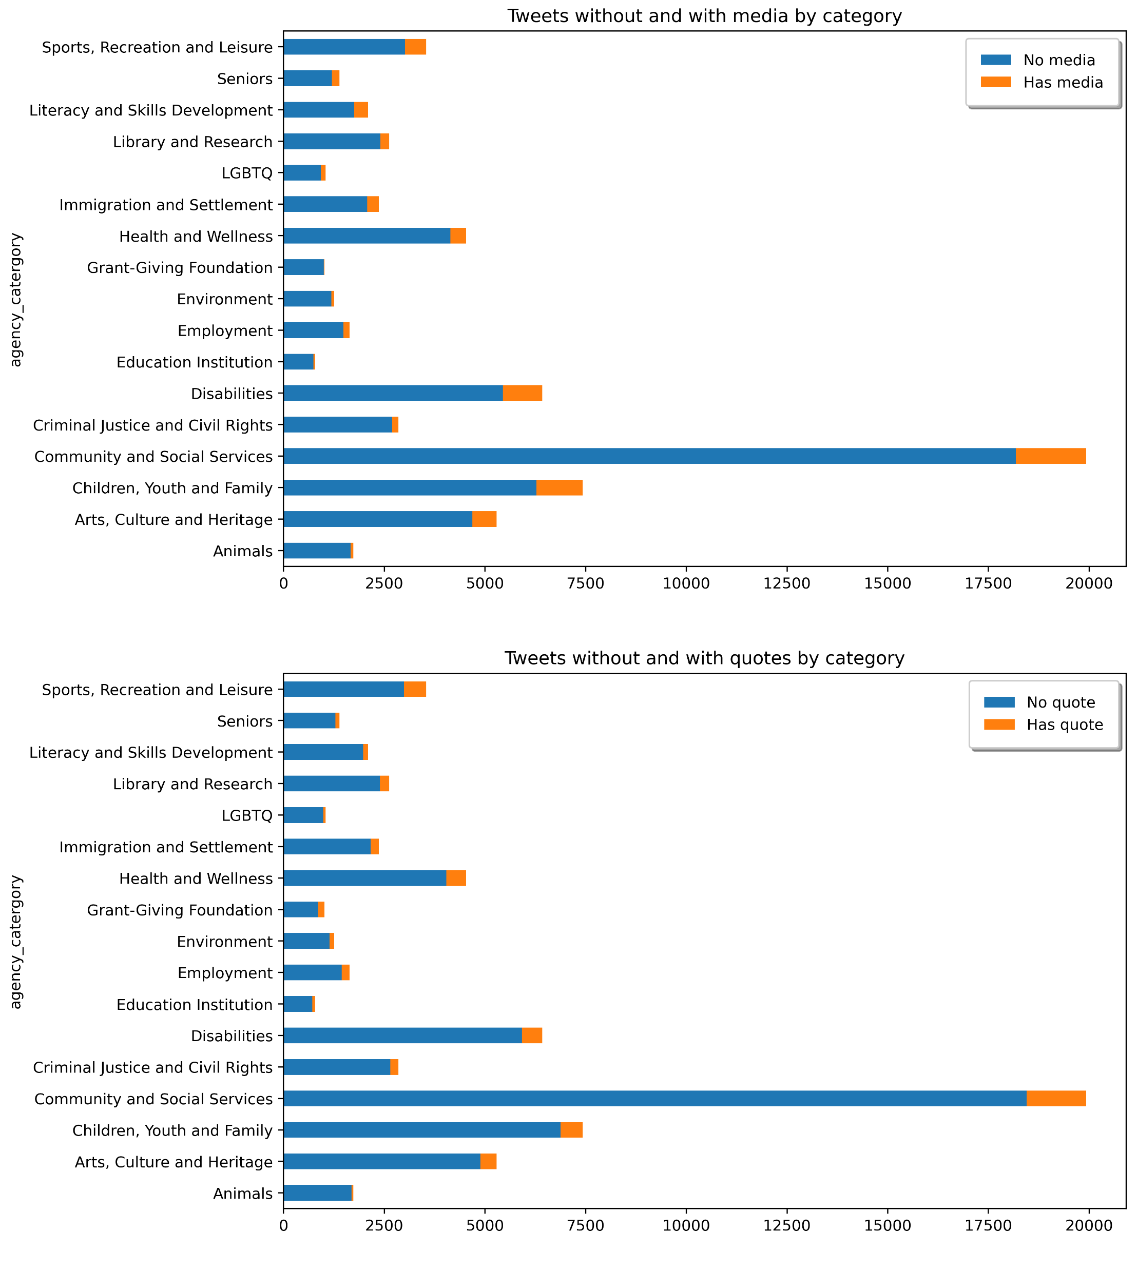
Strategies
Continued…
Results ... ?

Slide 8
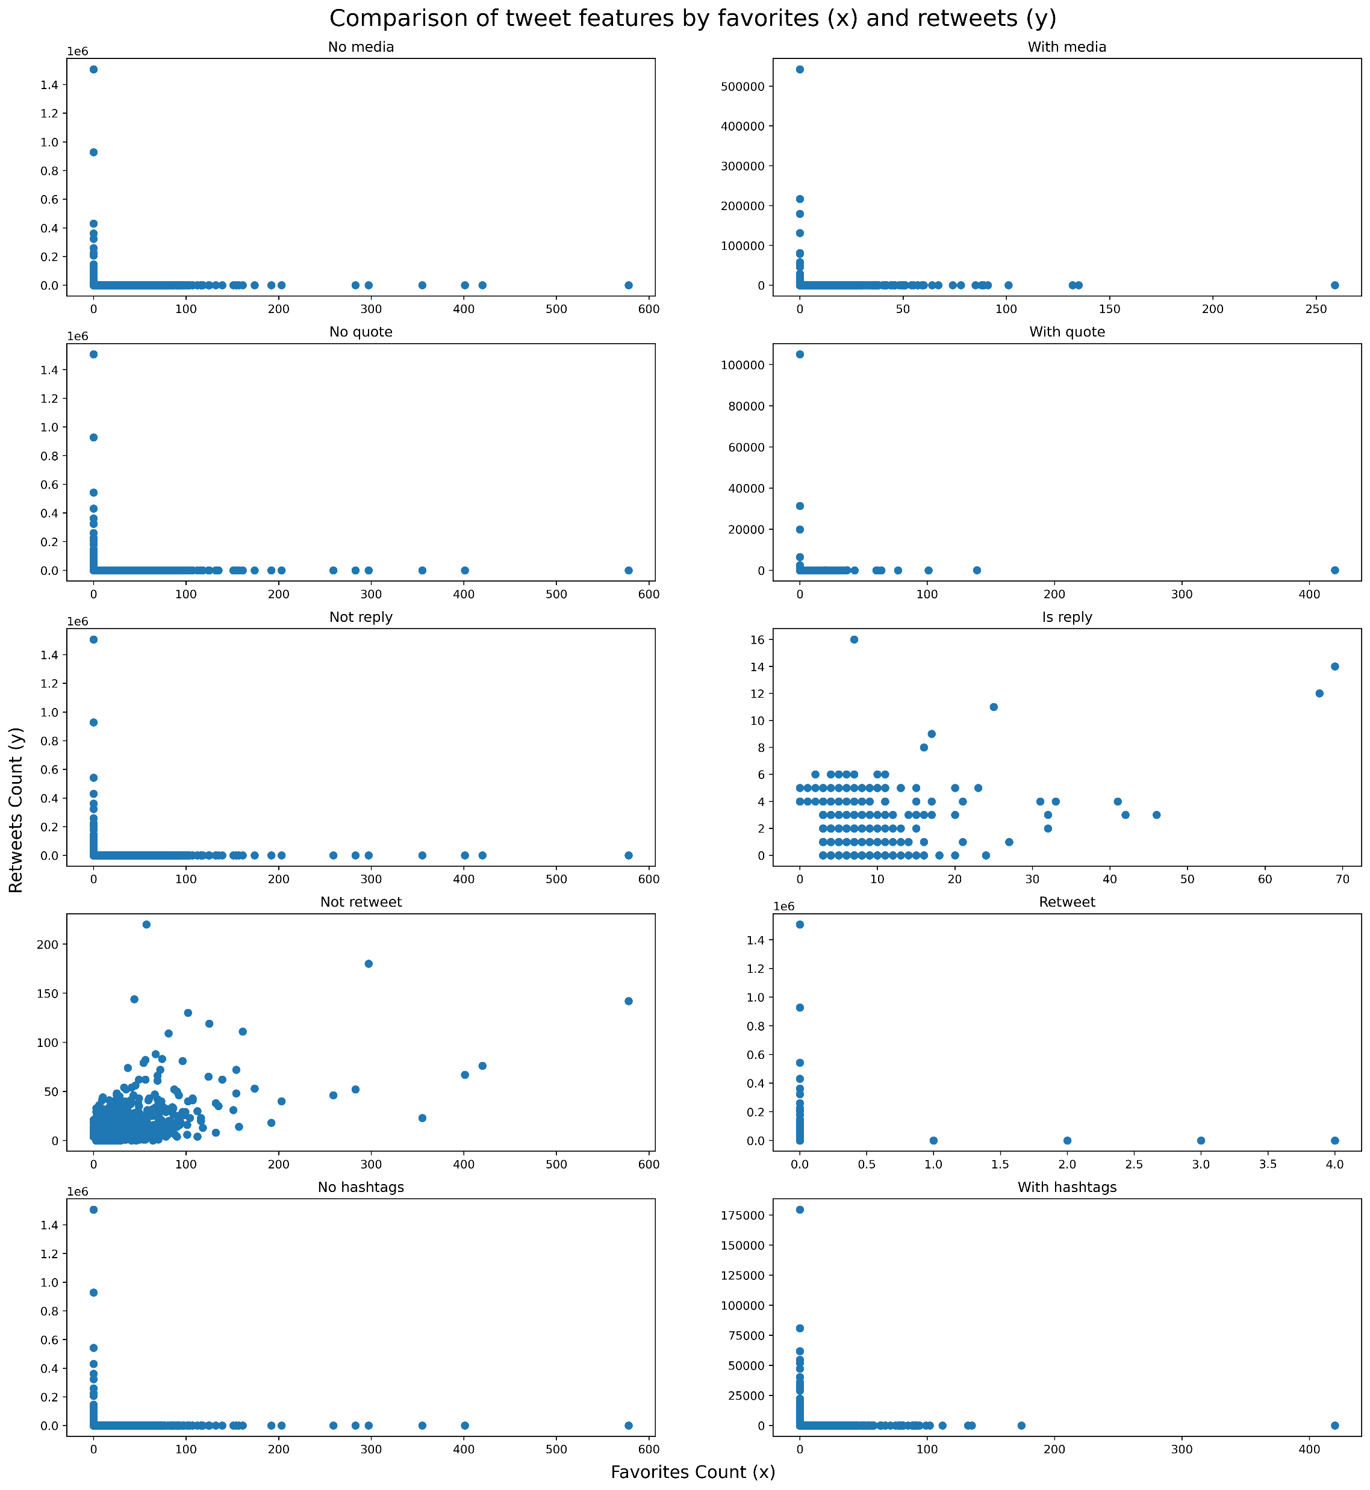
Results of strategies
Distribution of tweets with different features by count of favorites (x-axis) and retweets (y-axis)

Slide 9
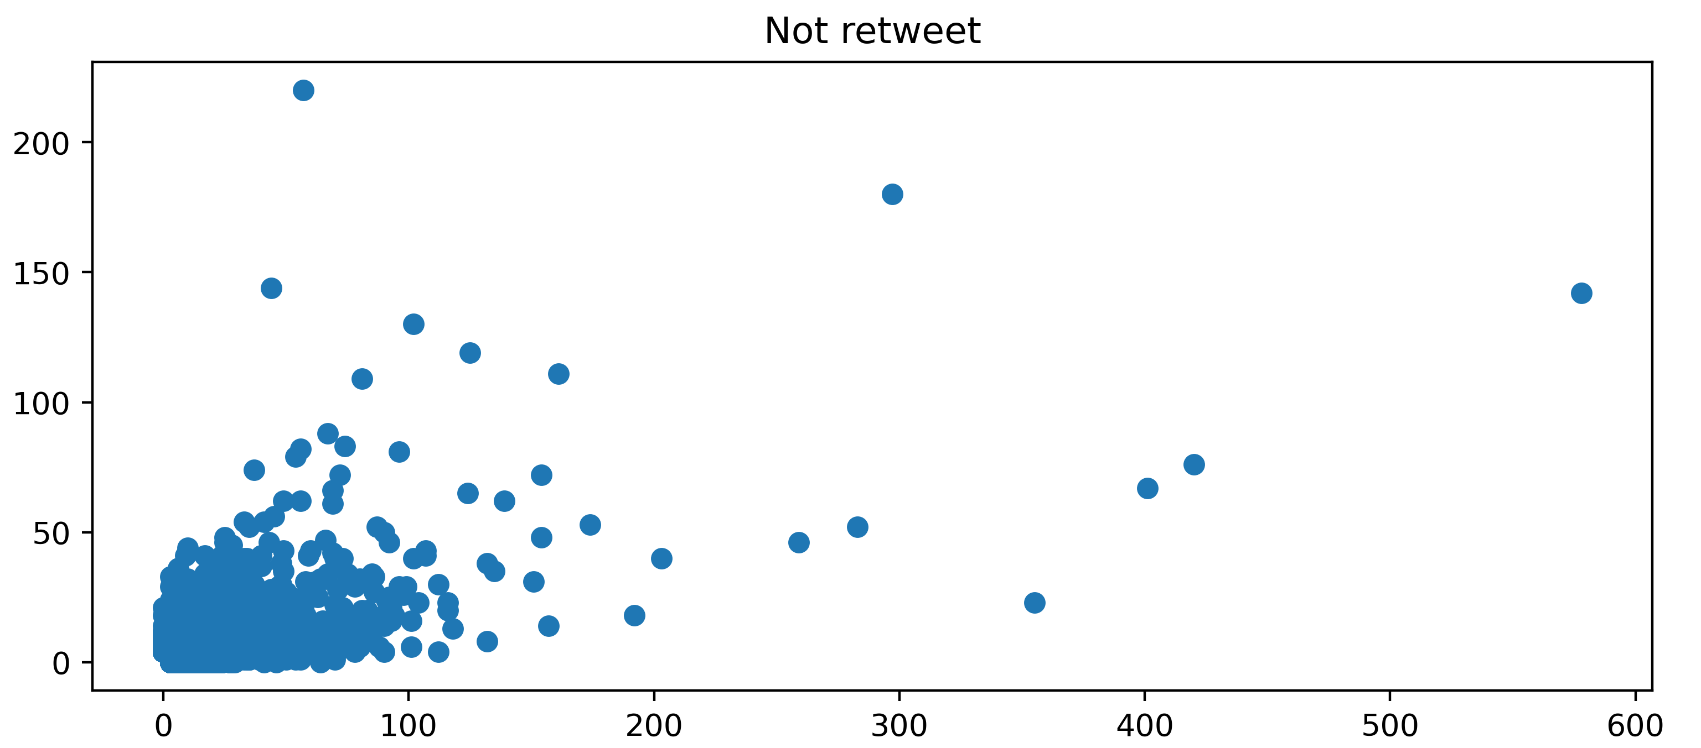
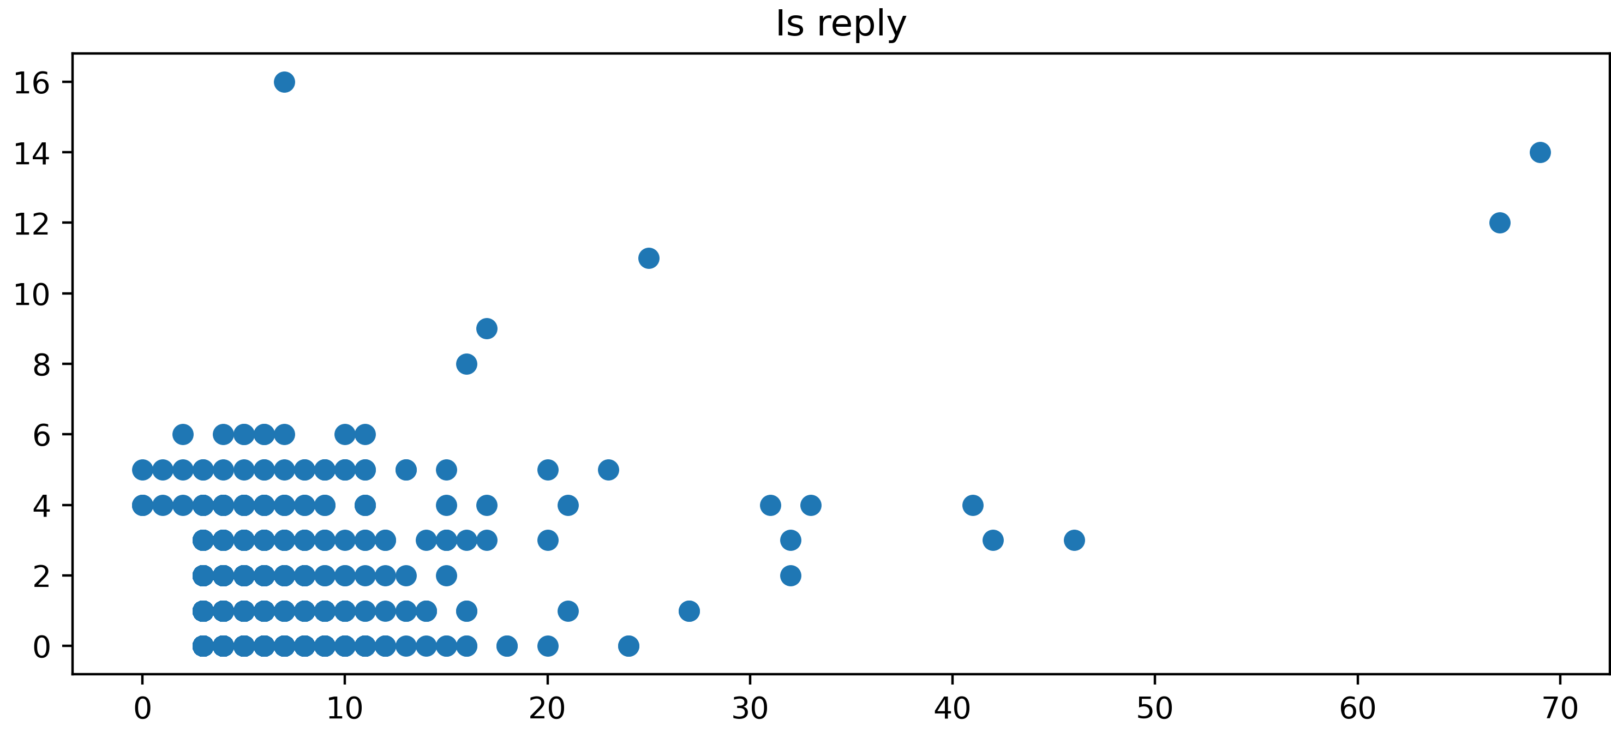
Potential ways to improve
Try to reply more often than retweeting others’ tweets
Set priority to be retweeted

Slide 10
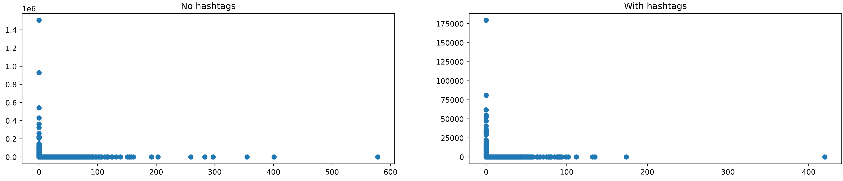
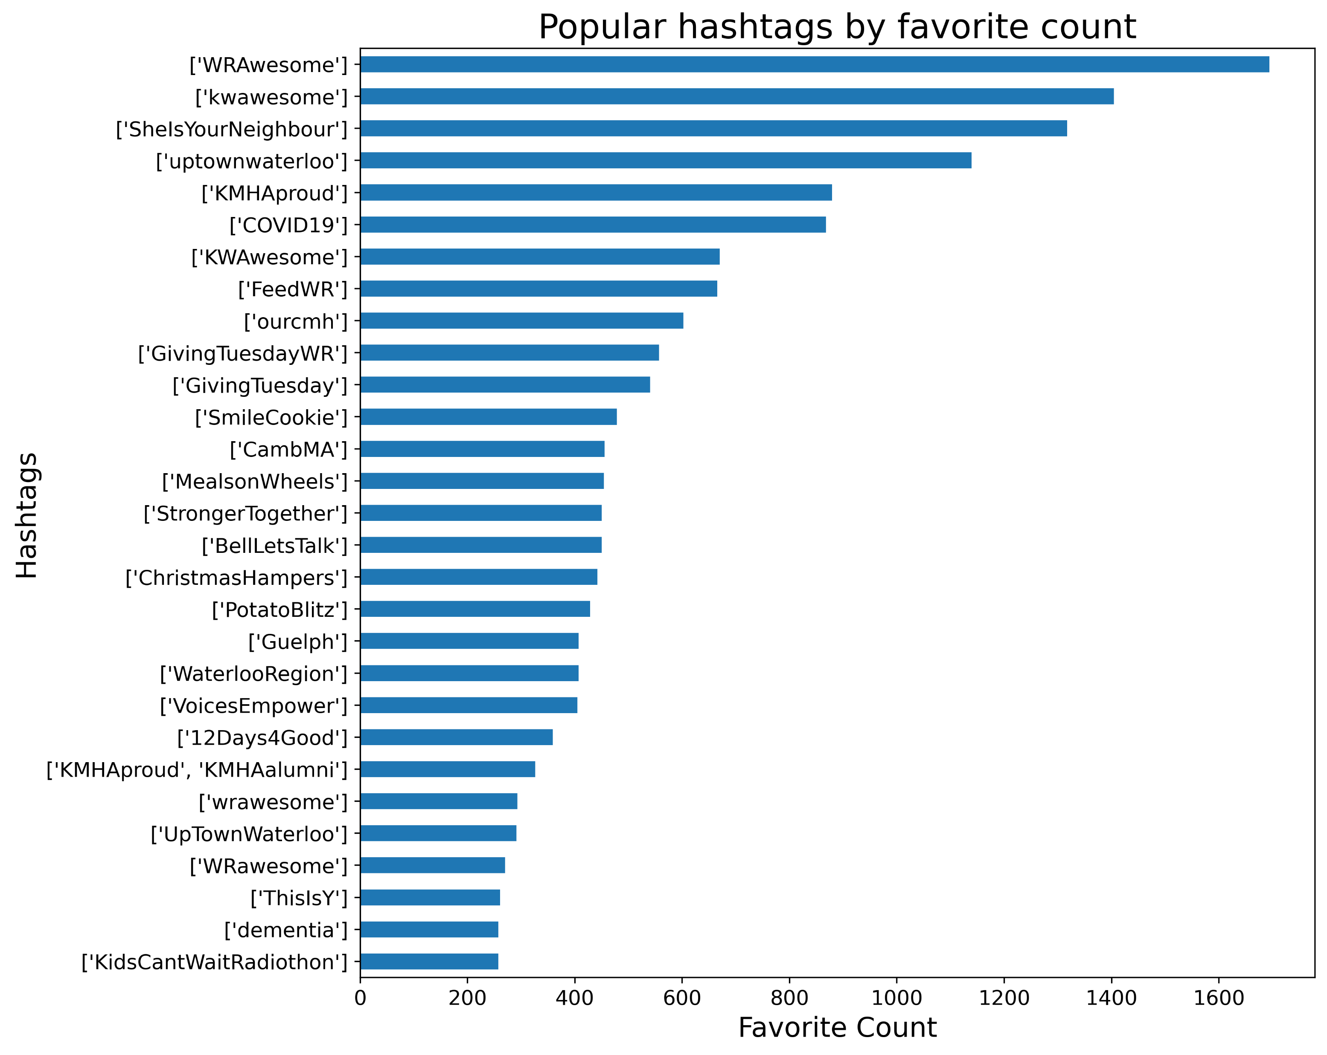
Hashtags
Hashtags seem to make little difference, if not deployed strategically.
We suggest:
Avoid retweeting only
Reply often to relevant tweets and incorporate hashtags
Use hashtags in your own tweets

Slide 11
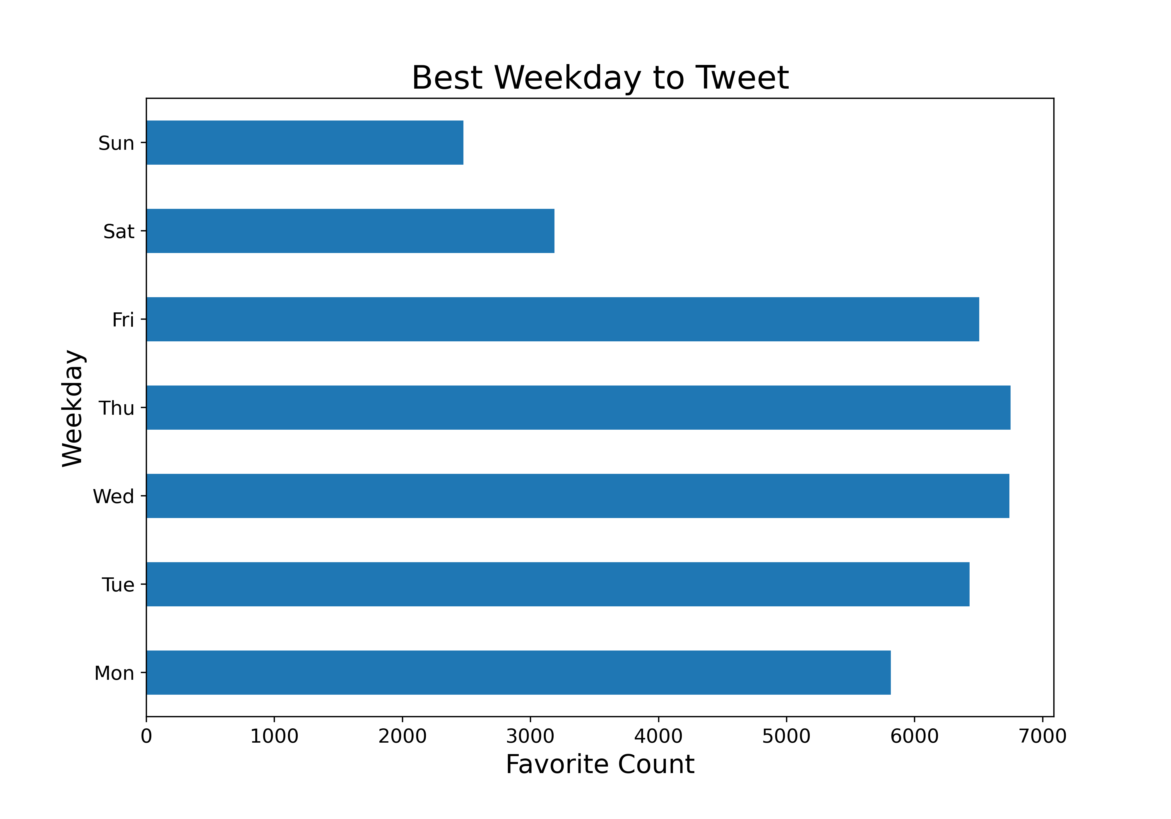
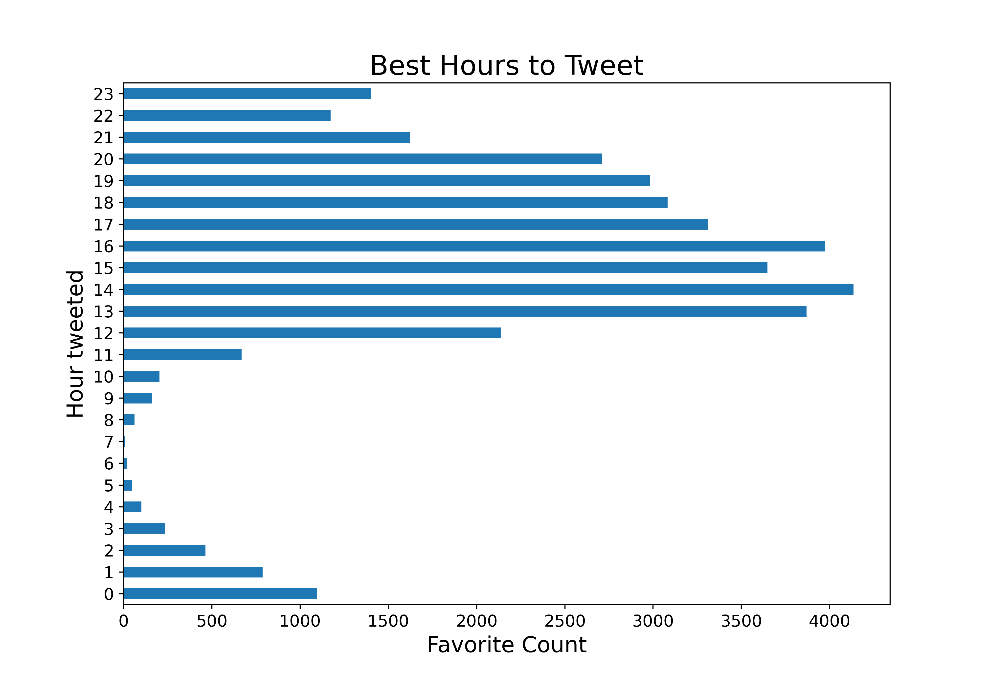
One more tip from data:
Best time to tweet on business days at lunchtime and afternoon

